Slide 1
Software for Intervention of Speech & Sound Disorders
PIP4004 University Project
Final Review
Batch Number: CSE G-40
Roll Number | Student Name
G. LAHARI | 20211CSE0152
ROHIT BHUNIA | 20211CSE0092
L. RACHANA | 20211CSE0059
METLA SRINIVAS | 20211CSE0090
Under the Supervision of,
Ms. Megala G.
Assistant Professor
School of Computer Science and Engineering
Presidency University
Name of the Program: B. Tech. CSE
Name of the HoD: Dr.Asif Mohammed H.B
Name of the Program Project Coordinator: Mr. Amarnath J.L & Dr. Jayanthi. K.
Name of the School Project Coordinators: Dr. Sampath A K / Mr. Md Ziaur Rahman

Slide 2
Content
Problem Statement
Analysis of Problem Statement
Objectives
Literature Survey
Proposed Methodology
Results
Timeline of the Project
Conclusion
Github Link
Journal Publication
References

Slide 3
Problem Statement Number:
Organization: Ministry of Social Justice and Empowerment
Category (Hardware / Software / Both) : Software
Problem Description: PSCS_57
Difficulty Level: Complex

Slide 4
Analysis of Problem Statement
Technology Stack Components:
1. Frontend:
Flask-HTML: For interactive speech therapy UI.
Bootstrap: For styling the web app.
2. Backend:
Flask(Web Framework): API and backend logic.
MongoDB / Firebase(Database): Store user speech data, progress, and history.
3. Programming Language:
Python: Primary language for speech processing, API integration, and phoneme analysis.
4. Speech Processing & NLP Libraries:
Speech-to-Text (STT): Converts spoken input to text.
Text-to-Speech (TTS): Converts text feedback into speech.
Phoneme Analysis: Retrieves English word phonemes.
Hindi Phoneme Mapping: Maps Hindi words to phonetic representations.
5. Audio Processing & Analysis:
Audio Processing(pydub): Handles audio conversion & analysis.
Real-time Audio Input: Captures live microphone input.
6. Machine Learning & AI:
Speech Disorder Detection(TensorFlow/PyTorch): Train ML models for mispronunciation detection.

Slide 5
Analysis of Problem Statement (contd...)
Problem Statement: Developing an AI-powered software solution for the intervention of speech sound disorders in Hindi and English, incorporating perceptual and production training using speech recognition, visual and auditory feedback, and phoneme articulation analysis to assist individuals with speech and language disabilities.
Solution: The proposed software will integrate motor-based intervention techniques with speech perception and production training for individuals with speech sound disorders (SSD). It will use speech-to-text APIs, phoneme recognition, and real-time feedback to help users distinguish between correct and incorrect pronunciations.
Key Features of the Solution:
Perceptual Training (Ear Training):
The software will provide correct and incorrect speech examples for users to identify and compare.
It will include visual feedback (e.g., waveforms, spectrograms) to enhance phoneme distinction.
Real-time speech recognition and recording will allow users to listen to their own pronunciation and compare it with the correct model.
Adaptive Learning & Tracking:
AI-based error detection and personalized feedback will help users improve gradually.
The software will track progress over time, aiding clinicians and caregivers in monitoring improvements.
Multilingual Support (Hindi & English):
The intervention system will support both Indian English and Hindi phonemes to bridge the gap in existing resources.
Accessibility & Rural Outreach:
Given that trained therapists are concentrated in urban areas, the software will provide self-paced learning with flexible session scheduling, helping individuals in rural regions access speech therapy without geographical constraints.

Slide 6
Objectives
Develop AI-powered speech therapy software for Hindi and English to assist individuals with speech sound disorders.
Implement perceptual training using speech recognition, auditory cues, and visual feedback.
Enable production training with real-time pronunciation assessment and 3D articulatory animations.
Provide personalized learning and progress tracking with adaptive exercises and user dashboards.
Ensure accessibility and scalability through cloud-based and mobile-friendly solutions.
Integrate AI for automated feedback using speech-to-text and mispronunciation detection models.
Support multilingual and customizable training to accommodate different user needs.
Validate effectiveness through user trials involving speech therapists and individuals with SSD.

Slide 7
Literature Survey
"Age-related changes in segmental accuracy and error production in Korean-English bilingual children: A longitudinal study". Authors: Jae-Hyun Kim, Elaine Ballard, Clare M. McCann. Summary: This longitudinal study investigates age-related changes in speech accuracy and error patterns among Korean-English bilingual children, providing insights into typical bilingual phonological development. Link:https://www.tandfonline.com/doi/full/10.1080/2050571X.2017.1317754
"A Systematic Review of Interventions for Multilingual Preschoolers With Speech and Language Disorders". Authors: Kathryn Crowe, Sharynne McLeod, Sarah Verdon. Summary: This systematic review examines various interventions for multilingual preschoolers with speech and language disorders, highlighting effective strategies and the need for culturally responsive practices. Link: https://reachoutandread.org/wp-content/uploads/2023/07/JSL6411_Crowe.pdf
"A systematic review and classification of interventions for speech sound disorder in preschool children". Authors: Yvonne Wren, Susan Roulstone, Peter J. Miller. Summary: This review classifies and evaluates various interventions for speech sound disorders in preschool children, providing a comprehensive analysis of treatment efficacy.Link:https://pubmed.ncbi.nlm.nih.gov/29341346/
"Intervention for Multilingual Children with Speech Sound Disorders". Authors: Sharon McLeod, Brian A. Goldstein. Summary: This book chapter discusses approaches to intervention for multilingual children with speech sound disorders, emphasizing the importance of considering all languages in therapy. Link: https://www.degruyter.com/document/doi/10.21832/9781847695147-028/html
"Intelligibility in Context Scale (ICS)". Authors: Sharynne McLeod, Kathryn Crowe. Summary: The ICS is a parent-report measure designed to assess children's speech intelligibility across different contexts and listeners, useful for evaluating multilingual children's speech. Link: https://www.csu.edu.au/research/multilingual-speech/speech-assessments/ics

Slide 8
RESEARCH GAPS
Limited Multilingual Support
Lack of Personalization
Insufficient Real-Time Feedback
Scalability and Cost Constraints
Lack of Emotional and Behavioral Monitoring

Slide 9
PROPOSED METHODOLOGY
Data Collection and Preprocessing
Feature Extraction
Disorder Classification Using Machine Learning
Real-Time Feedback System
Therapy Module and Progress Tracking
Multilingual and Accessibility Support
Deployment and Testing

Slide 10
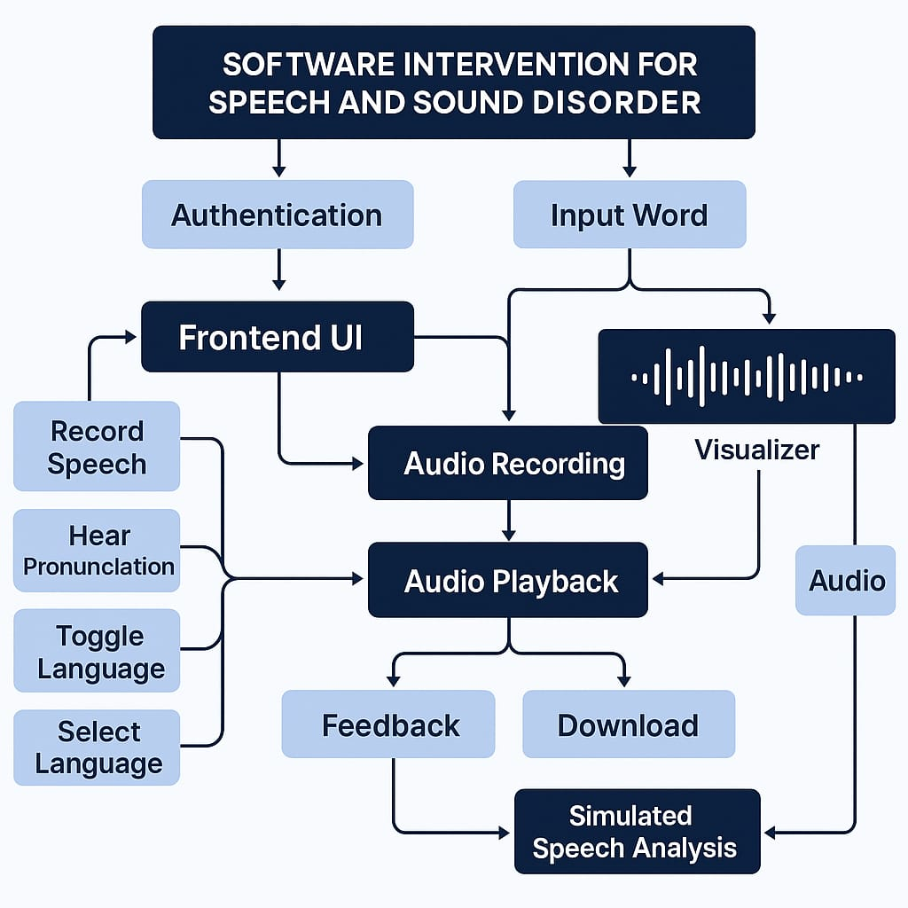
System Architecture

Slide 11
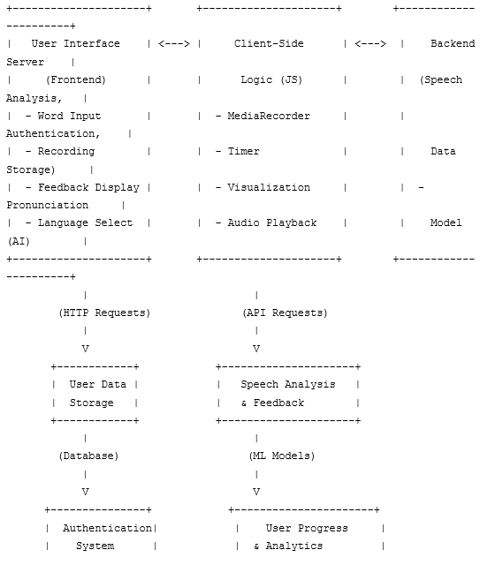
System Design Diagram

Slide 12
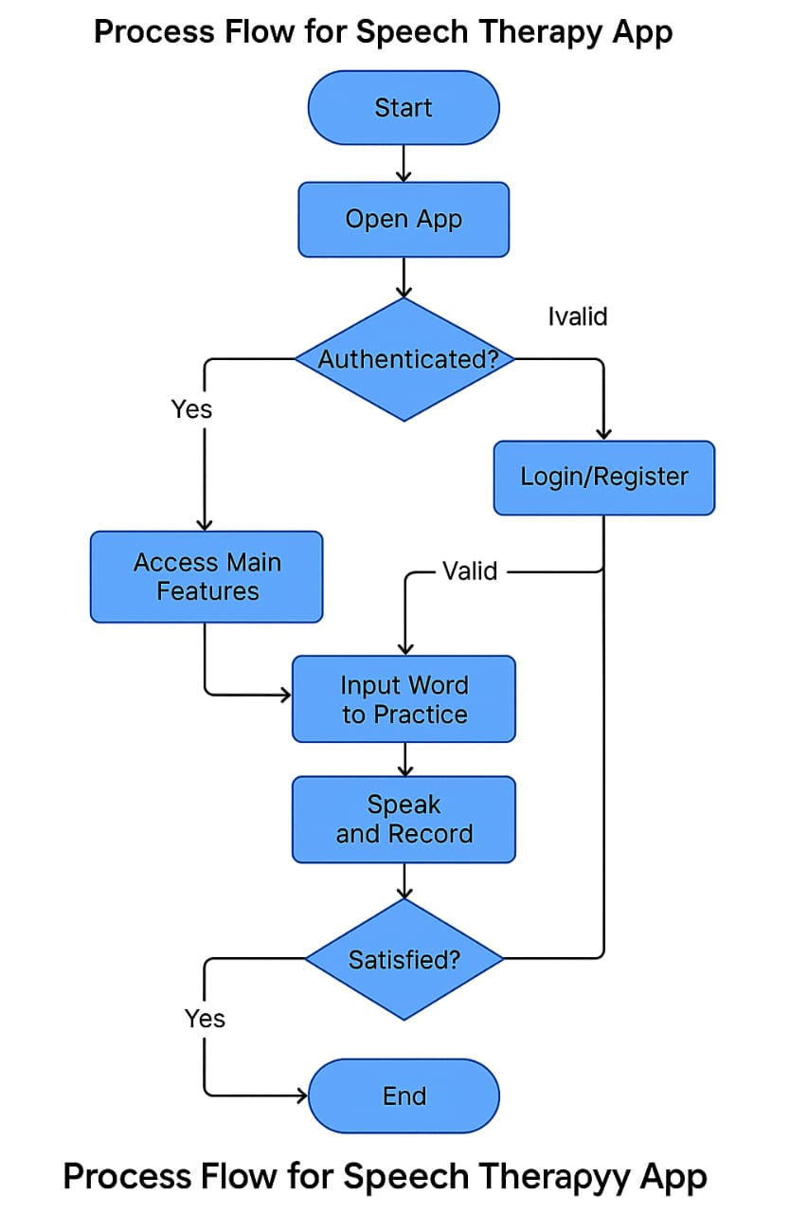
Data Flow and Interaction

Slide 13
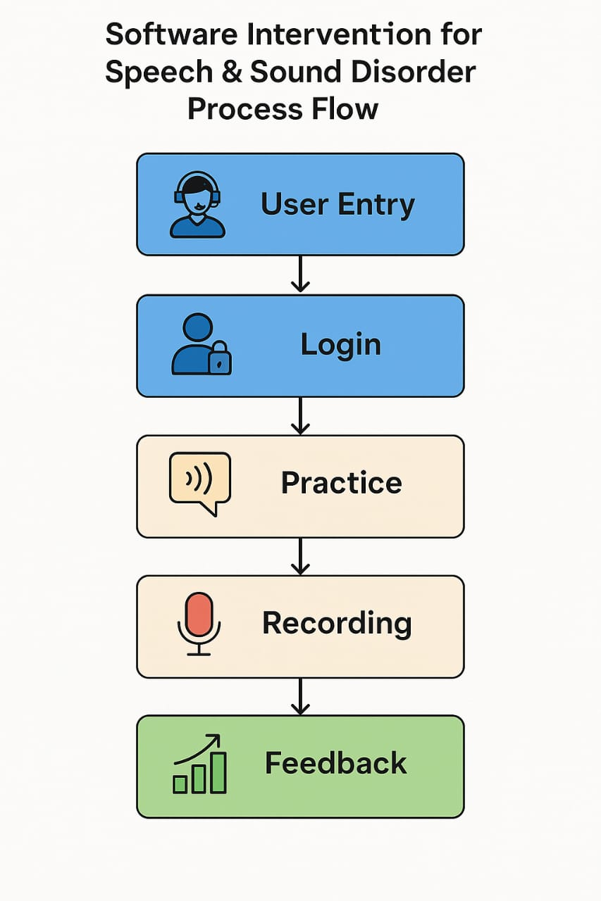
Module Interaction and Workflow

Slide 14
Hardware & Software Requirements
Software Requirements:
1. Programming Languages (Python): Used for speech processing, backend development, and AI/ML models.
2. Speech Processing API (Speech-to-Text API/Text-to-Speech API): Converts spoken input to text and generates auditory feedback.
3. Backend Framework (Flask): Provides API services and application logic.
4. Frontend Framework (React.js): Used if a web/mobile interface is needed.
5. Database (optional)(MongoDB): Stores user progress, speech data, and learning history.
6. Audio Processing Libraries (librosa, pydub): Handles speech feature extraction, visualization, and audio manipulation.
7. Machine Learning Frameworks (Optional)(TensorFlow / PyTorch): If custom phoneme recognition or speech assessment models are needed.
8. Development Environment (VS Code): IDEs for writing and debugging the code.
9. Testing Tools (Postman, PyTest, Selenium): For API, unit, and UI testing.
Hardware Requirements:
1. Processor (Intel i5 (8th Gen) / AMD Ryzen 5): Sufficient for basic speech processing and API calls.
2. RAM (8GB): Needed for handling multiple API calls and speech feature extraction.
3. Microphone: Essential for capturing speech input.
4. Storage: SSD recommended for faster data processing.

Slide 15
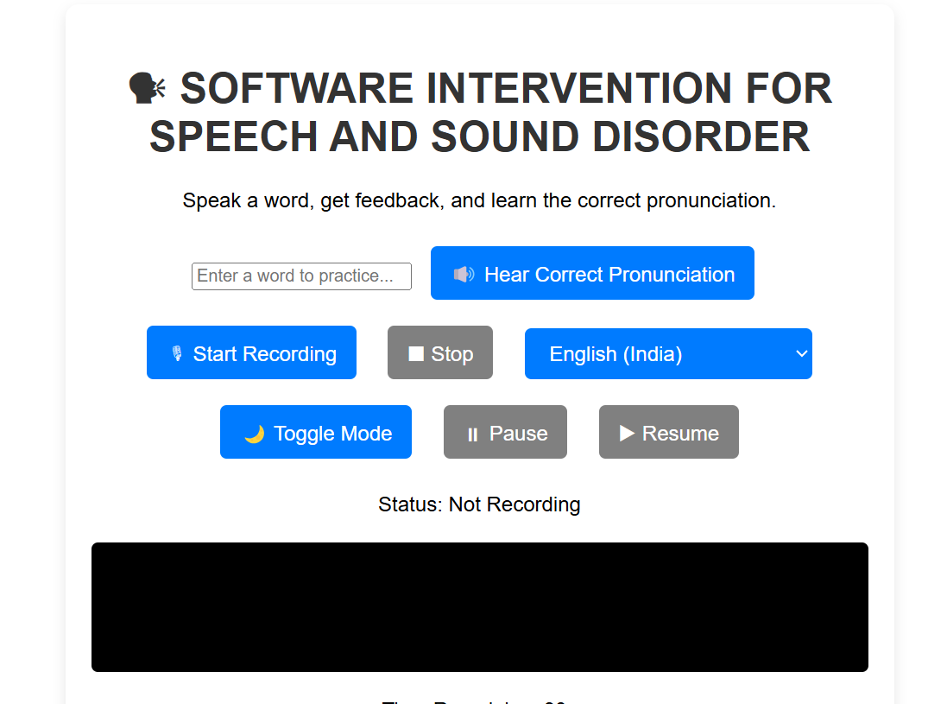
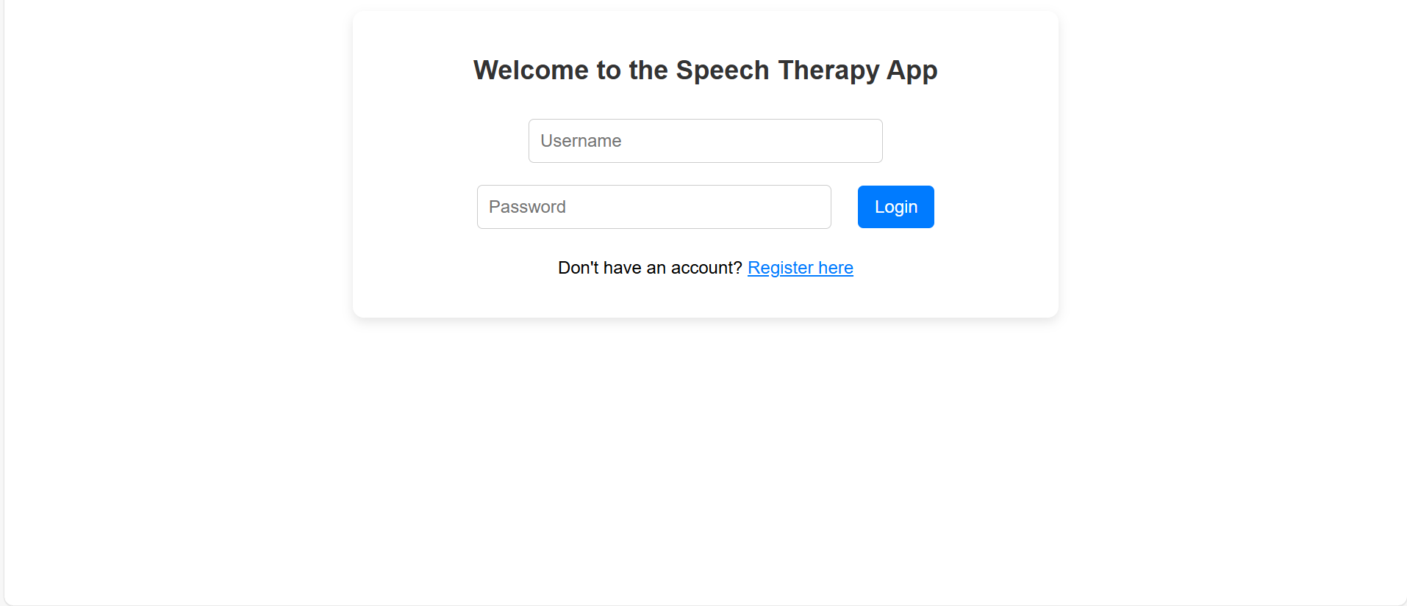
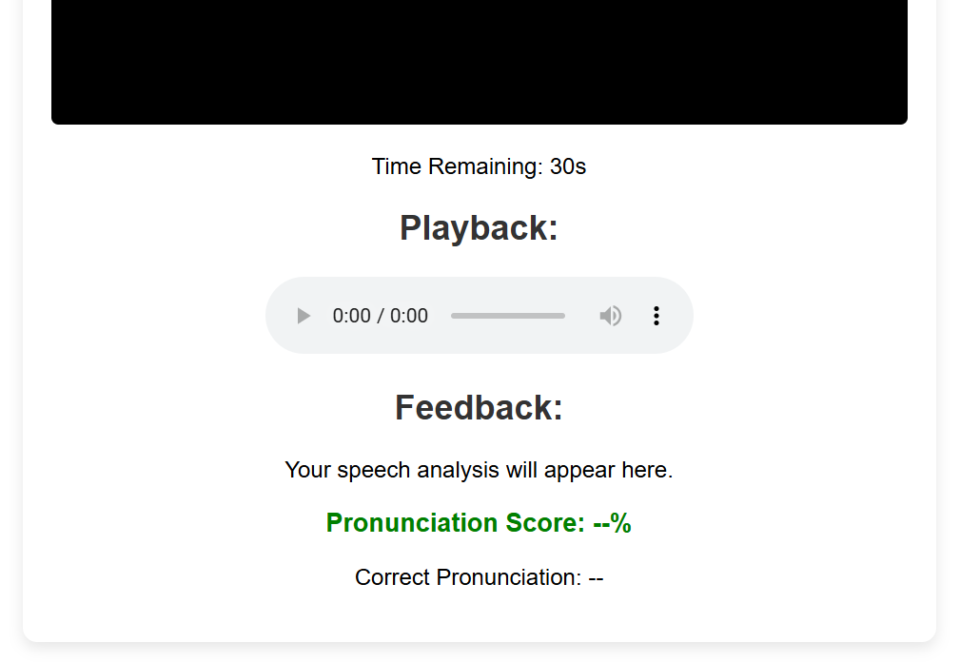
Outputs

Slide 16
Timeline of the Project (Gantt Chart)
Task/Activity | Phase 0 | Phase 1 | Phase 2 | Phase 3
Problem discussion and finalize features for time table generation. | __30/01/2025_______
Data collection for schedules, rooms, invigilators, and other resources. |  | ___21/02/2025______
Developing and implementing the time table generation algorithm. |  |  | ____23/03/2025_____
Testing and presenting the system. |  |  |  | _____23/04/2025____

Slide 17
Conclusion
speech intervention software not only supports the traditional therapy model but also expands its reach, efficiency, and adaptability. It is a valuable tool in the ongoing effort to improve communication abilities and enhance the quality of life for individuals affected by speech and sound disorders.

Slide 18

GitHub Link and SDG Goal Mapping
This is the Github link for our project:
Github Link : https://github.com/Laharigandla/University-Project.git
The Project work carried out here is mapped to SDG-4 Quality Education.
This project contributes to improving education by developing innovative learning methods and enhancing access to quality resources. It helps bridge educational gaps and promotes inclusive and equitable learning for all.

Slide 19
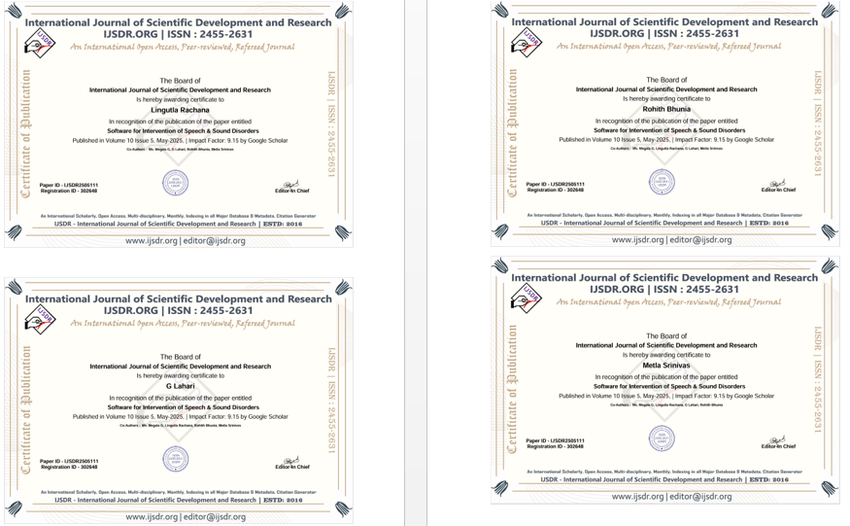
Publication

Slide 20
References
Deka, C., Shrivastava, A., Abraham, A. K., Nautiyal, S., & Chauhan, P. (2022). AI-Based Automated Speech Therapy Tools for Persons with Speech Sound Disorders: A Systematic Literature Review. arXiv preprint arXiv:2204.10325. This paper presents a comprehensive review of AI-based automated speech therapy tools, discussing their effectiveness and the degree of automation compared to human experts. ARXIV.ORG
Benway, N. R., & Preston, J. L. (2023). Prospective Validation of Motor-Based Intervention with Automated Mispronunciation Detection of Rhotics in Residual Speech Sound Disorders. arXiv preprint arXiv:2305.19090. This study validates a motor-based intervention using automated mispronunciation detection, highlighting the potential of AI in speech therapy. ARXIV.ORG
Preston, J. L., & Benway, N. R. (2024). Artificial Intelligence–Assisted Speech Therapy: A Single Case Study. American Journal of Speech-Language Pathology, 33(1), 1-10. This case study provides evidence of improvement in speech sound disorders through AI-assisted treatment, emphasizing the role of technology in therapy. PUBS.ASHA.ORG
Syracuse University News (2023). Researchers' Artificial Intelligence-Based Speech Sound Therapy Software Wins $2.5M NIH Grant. This article discusses the development of an AI-based speech sound therapy software aimed at improving treatment for speech sound disorders. NEWS.SYR.EDU
Tech4Future (2023). Speech Disorders: AI is Revolutionising Speech Therapy. This article explores how AI-powered screening tools enable rapid and accurate assessments of language skills, allowing for early diagnosis and timely interventions. TECH4FUTURE.INFO

Slide 21


